Slide 1

Outland Adventures Case Study July 23^{rd,} 2023

Slide 2

Group 2 Team Members
Ryan Church
Darius Dinkins
Taylor Donlea
Tanner Glaser

Slide 3
Case Study
Blythe Timmerson and Jim Ford, both outdoor enthusiasts, opened Outland Adventures as a sideline to their fulltime careers. They hoped to cater to other people who enjoyed hiking and camping in far off places. They thought that if they could arrange guided trips, provide the equipment needed, and develop the right advertising, then Outland Adventures might just succeed. When it became apparent that they had identified a much needed market, they both quit their current jobs and devoted their full time and energies into their joint venture.
When they started running Outland Adventures, they hired two guides; John ‘Mac’ MacNell, and D.B. ‘Duke’ Marland. These two would be in charge of organizing and planning the trips, including investigating airfares, visa requirements, and inoculations. Customers may either rent or buy their equipment outright. Mei Wong has just been hired to develop an ecommerce site where potential customers can find out information about Outland Adventures, check on trip schedules, and purchase hiking and camping equipment.
While Blythe and Jim have been taking care of the administrative and office operations, they have recently started wondering if it was time to optimize the organization.

Slide 4
Organizational Questions
Is there enough purchasing of inventory to continue offering that option?
Are there any aging items(over 5 years) in the inventory that might need replacement?
Are any of the destinations seeing a negative trend in bookings?

Slide 5
Activity Assumptions
One of the two guides will be tied to each trip
Locations likely will either require a visa or not, or require special immunizations or not. These were treated as Boolean type flags.
Assumed airfare costs are dependent on client’s location, so it was moved to the bookings table.
Having an inventory date for when the item was first available will aid in tracking age
A purchase flag/date makes it easy to track what has been purchased.
Assumed clients would book one or more trips

Slide 6
Table Details
Guides—list of guides available for a trip
Clients—personal info for clients who can book trips/rent equipment
Trips—instances of a trip to a given location
Bookings—list of clients associated with a given trip
Locations—potential travel destinations
Equipment—List of items available for rental or purchase, along with inventory date for when it came into inventory.
Rentals—Tracks client rentals of equipment

Slide 7
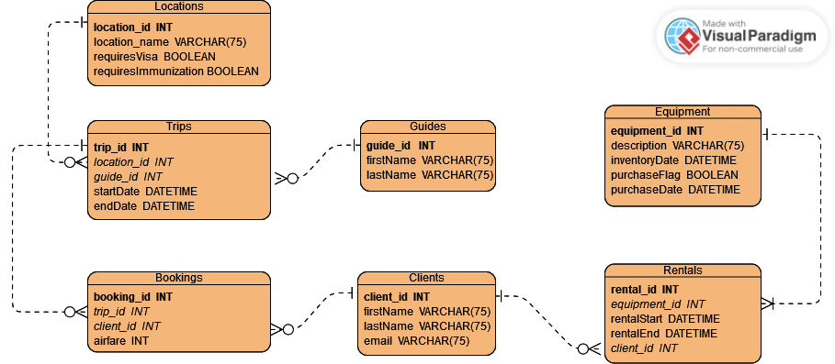
Final ERD Model

Slide 8
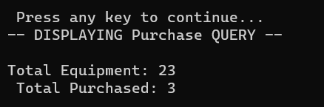
Equipment Sales
Outland Adventures wanted to tell whether offering equipment sales was worthwhile
A query was created to capture the total items purchased, as well as total items in the inventory table
As volume of purchased items is roughly 13% of the total, Outland Adventures could get rid of this infrequently used benefit.

Slide 9

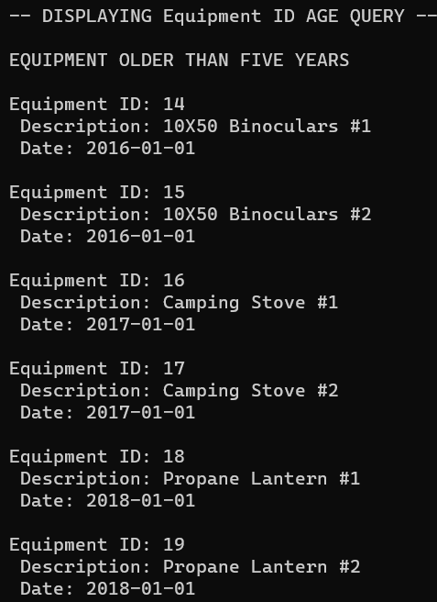
Aging of Equipment
An initial query was run to gauge if any inventory items were over 5 years old
From there, a more detailed query was run to identify those items that might need inspection/replacement
As more than a quarter of their inventory is over the 5-year mark, it’s likely that some of the items need to be refreshed.

Slide 10
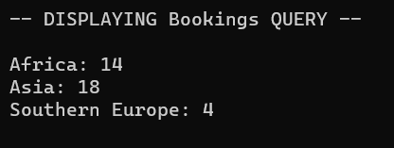
Popularity of Destinations
An initial query was run to gauge the total bookings by location
Trips to Southern Europe are the least popular offering in terms of overall bookings
Do we see any trend positive or negative in bookings? For that we’ll need another query

Slide 11
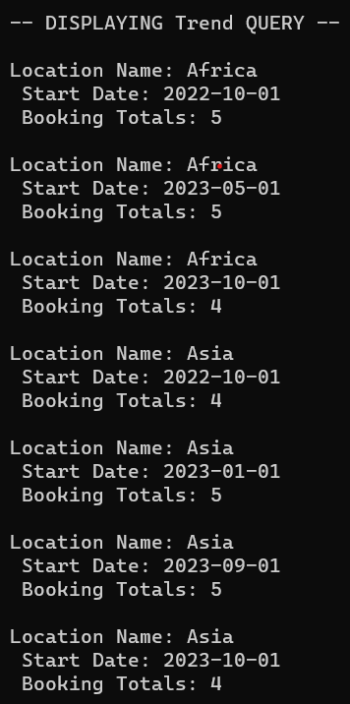
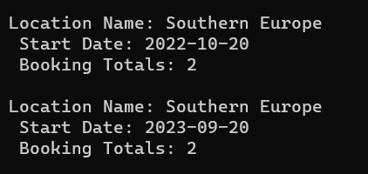
Popularity of Destinations Continued
Asia and Africa continue to have roughly the same # of clients for each outing
Trips to Southern Europe are consistently having the least number of participants when a trip is offered.
Outland Adventures may benefit from discontinuing the Europe trips and focusing more on the African and Asian Exepditions

Slide 12
Conclusions
Outland Adventures should look into more promotion of their Europe expedition to get more interest in that particular trip. The amount of equipment sales is marginal, but the new eCommerce site might lead to more opportunities. Tracking of sales needs to be reviewed to verify if it’s still worthwhile to continue Several pieces of equipment are over five years old, so these need to be assessed for safety/usability for the clients. In addition, tracking of the inventory age should help determine when reviews or replacement of equipment is needed.

